Slide 1
BOOTCAMP TRAINING ( TECHNOLOGIES AND PROJECT)
GROUP B: 1) GOVIND
2)SAI SANATH
3) Sai teja
4) Jyoti bhardwaj

Slide 2
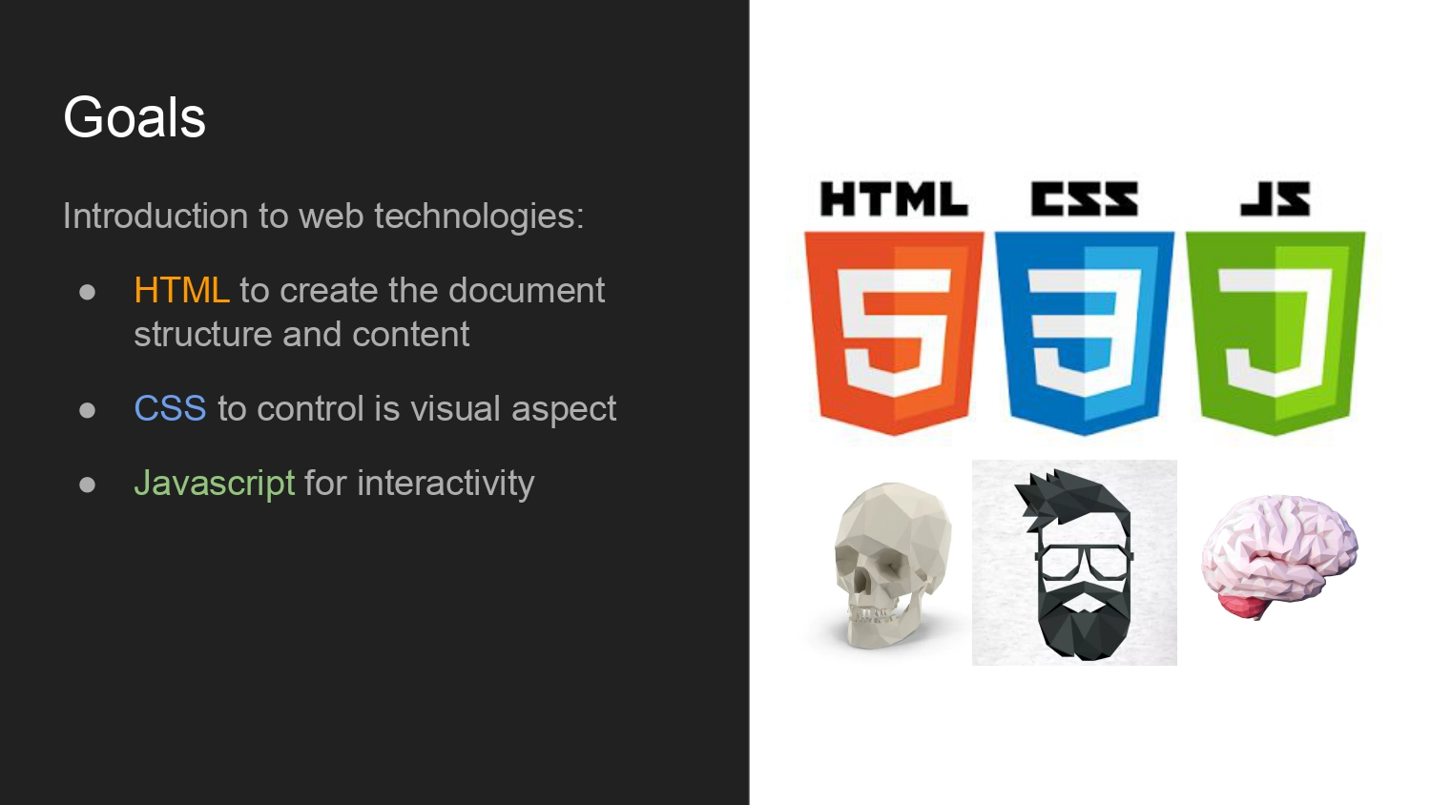
FRONT END:

Slide 3
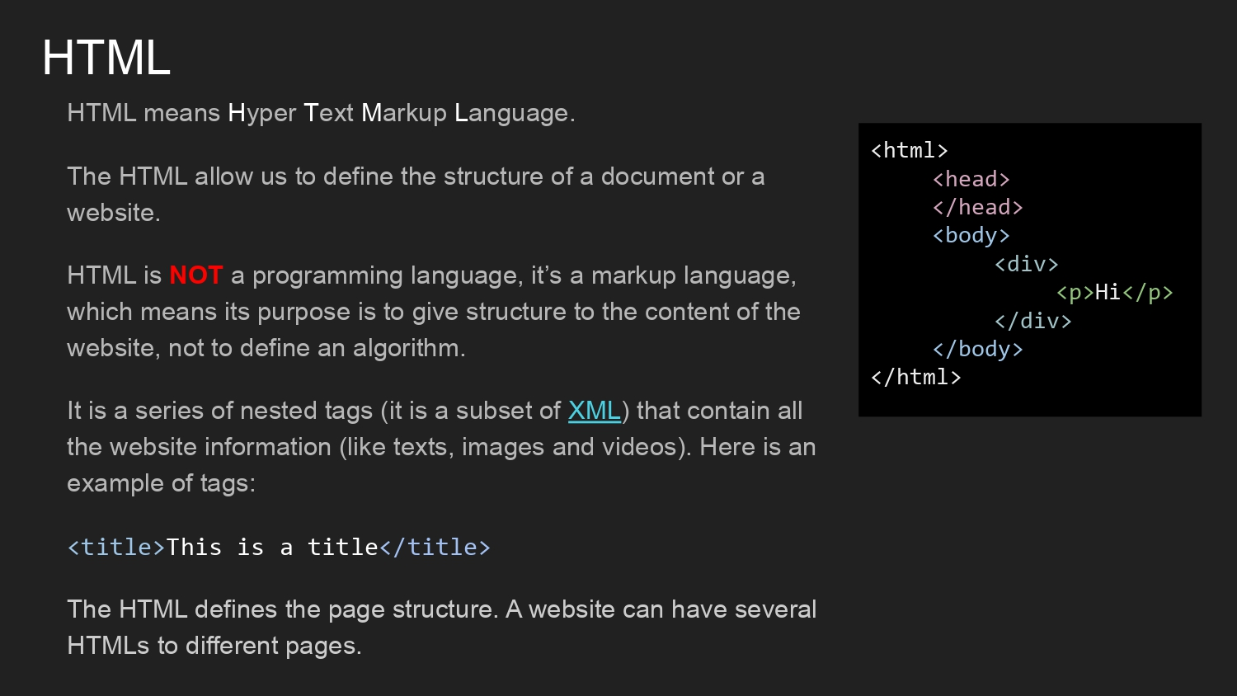
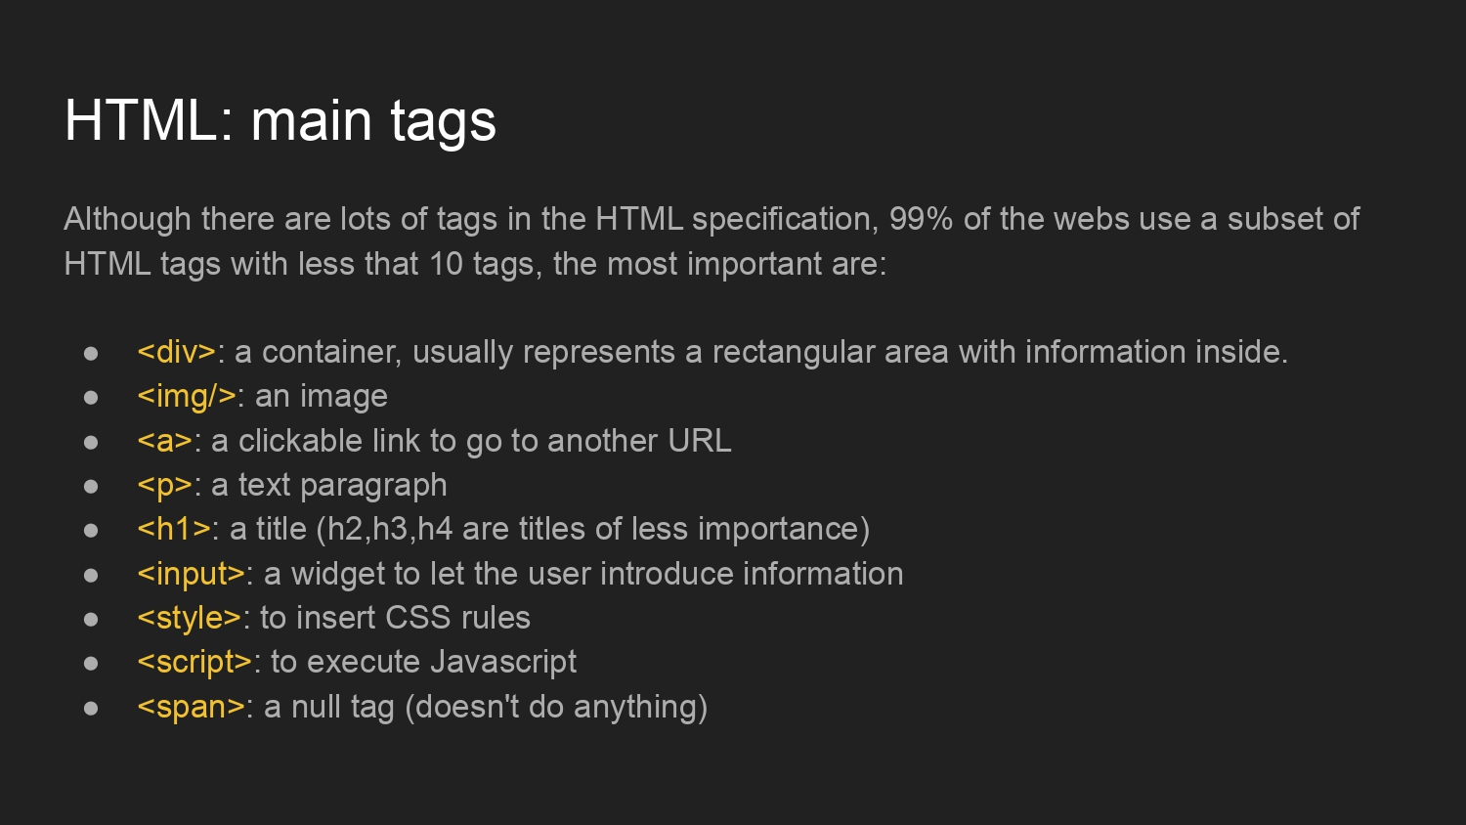
HTML

Slide 4
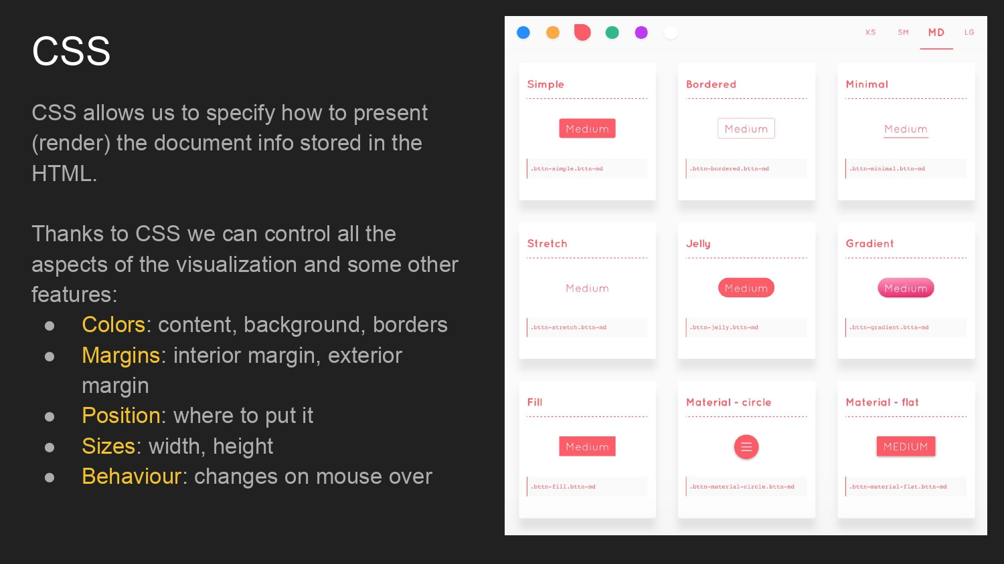
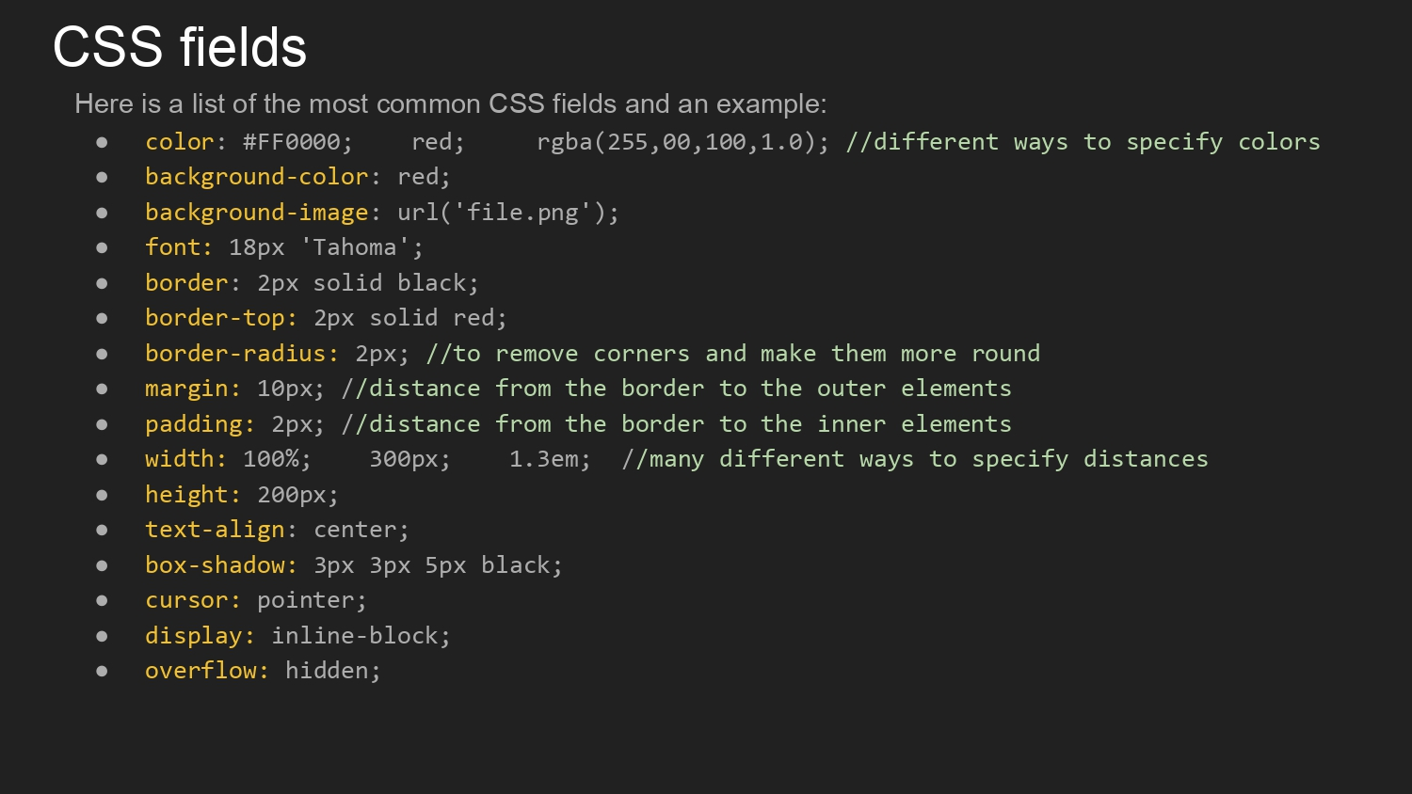
CSS:

Slide 5
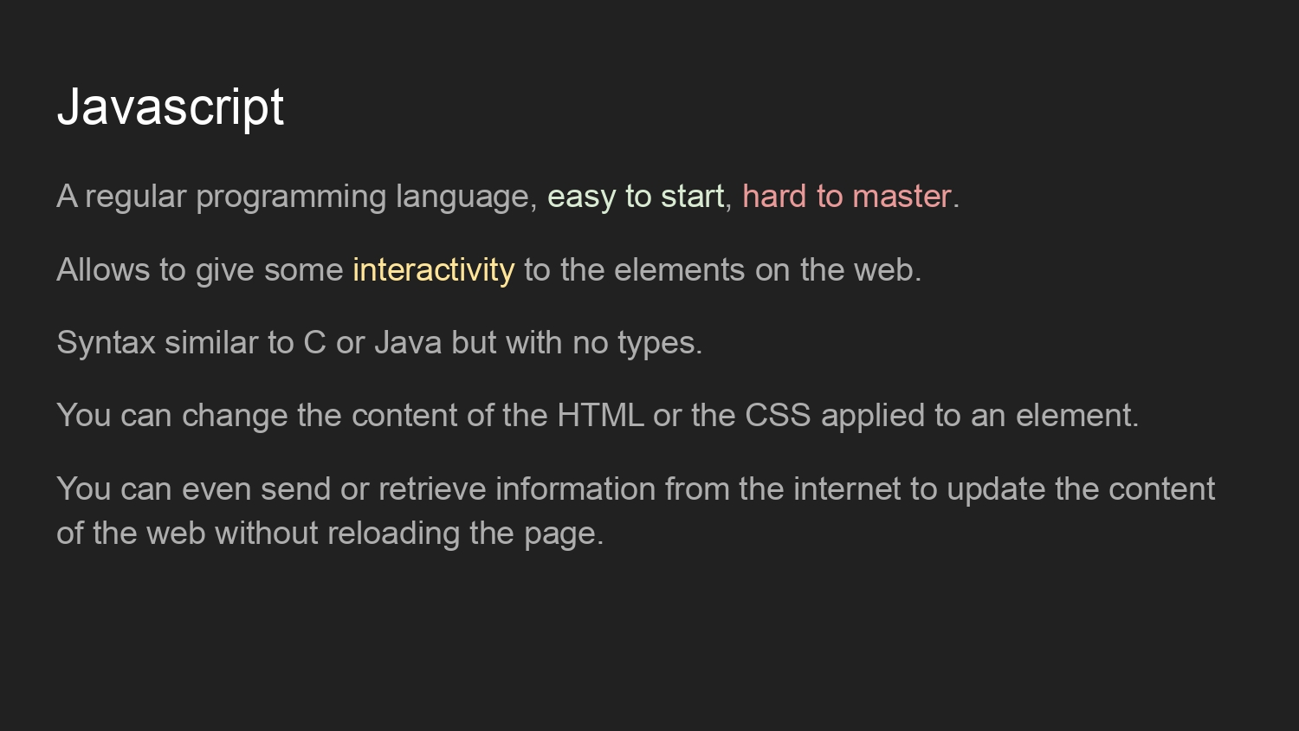
JAVASCRIPT:

Slide 6
BACK END:
SQL stands for Structured Query Language
SQL lets you access and manipulate databases
SQL became a standard of the American National Standards Institute (ANSI) in 1986, and of the International Organization for Standardization (ISO) in 1987
WHAT CAN SQL DO ?
SQL can execute queries against a database
SQL can retrieve data from a database
SQL can insert records in a database
SQL can update records in a database
SQL can delete records from a database
SQL can create new databases
SQL can create new tables in a database
SQL can create stored procedures in a database
SQL can create views in a database
SQL can set permissions on tables, procedures, and views

Slide 7
TIS Solutions Appraisal Systems

Slide 8
DESCRIPTION:
TIS Solutions has great work with their employees, with this in TIS Solutions they have increasing number of employees.
TIS solutions has a conflict about the employees and their accomplishments. It will implement appraisal strategies to keep
the motivational and performance level of their employees high. So, they want to implement this Appraisal System.
In the EMPLOYEE APPRAISAL APP all employees can know their performance with employee appraisal app. This performance can
be given in yearly, half-yearly, or quarterly to their employees. This will help the employees to grow up and enhance
skills with appraisal. This Appraisal module allows you to create top-down or bottom-up evaluation plans and give timely
feedback and compliments for accomplishments. By knowing all their performances employees will know all their
accomplishments and they can perform better next time.

Slide 9
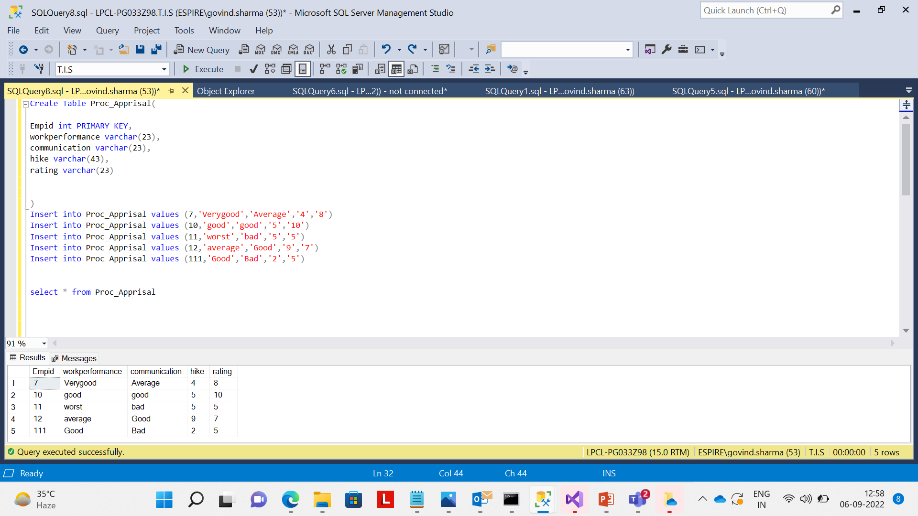
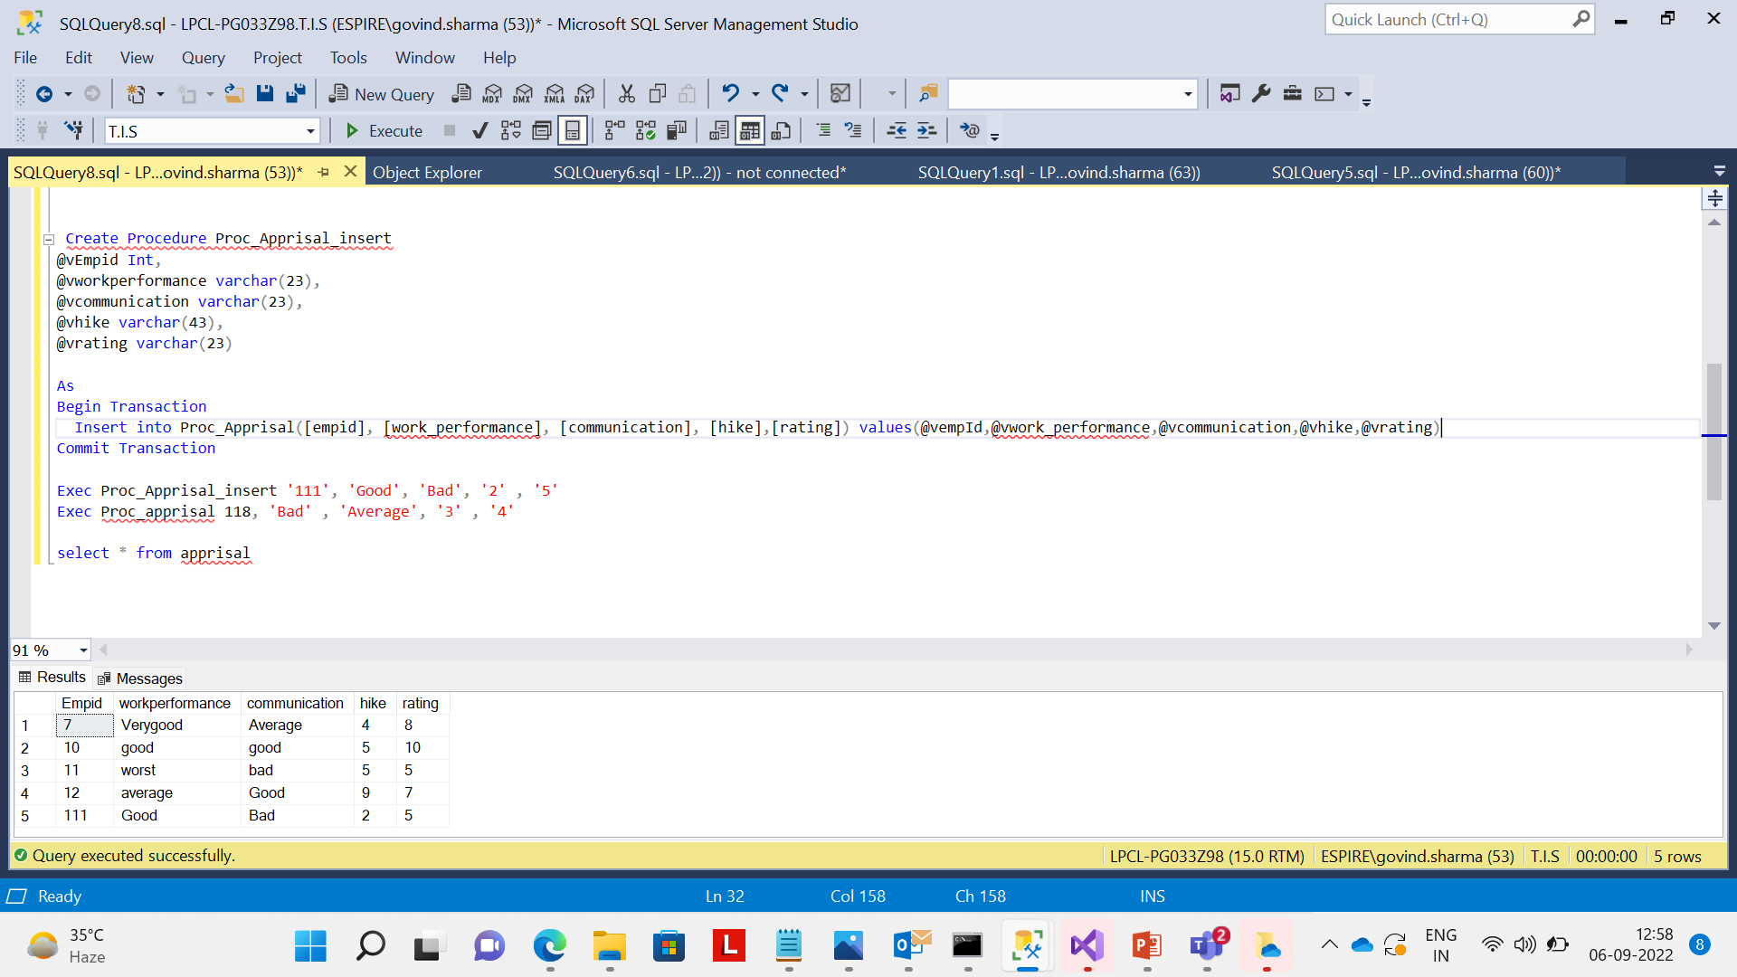
SNIPPETS FROM THE DATABASE: GOVIND

Slide 10
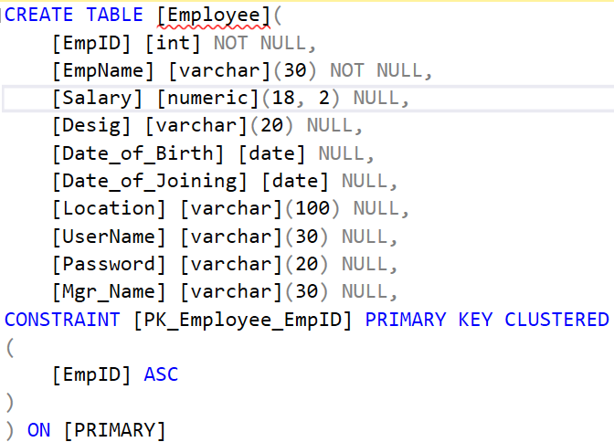
SNIPPETS FROM THE DATABASE: SAI SANATH

Slide 11
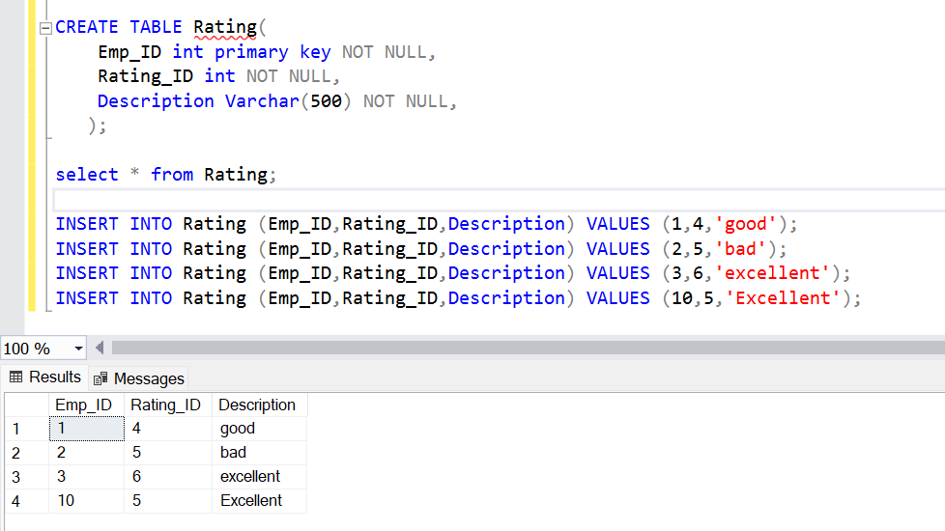
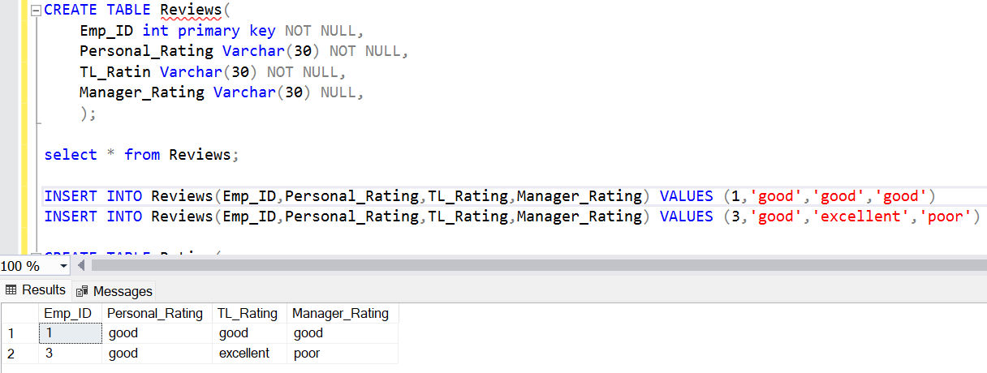
SNIPPETS FROM THE DATABASE: SAI TEJA

Slide 12
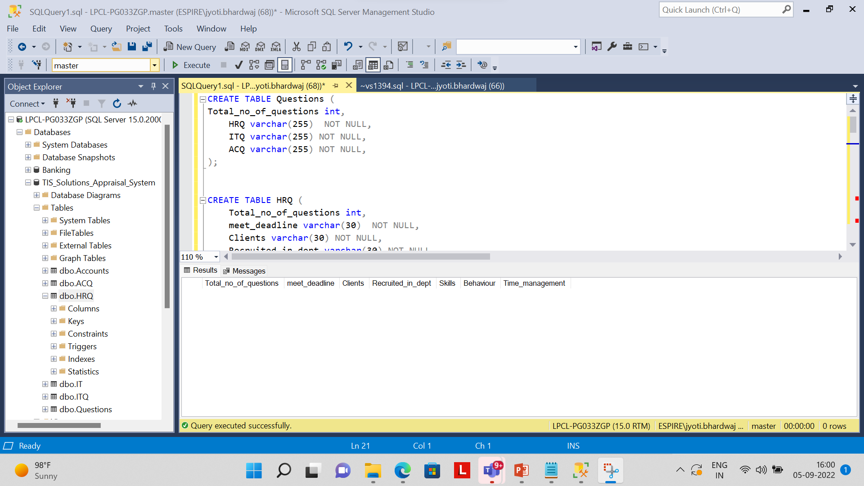
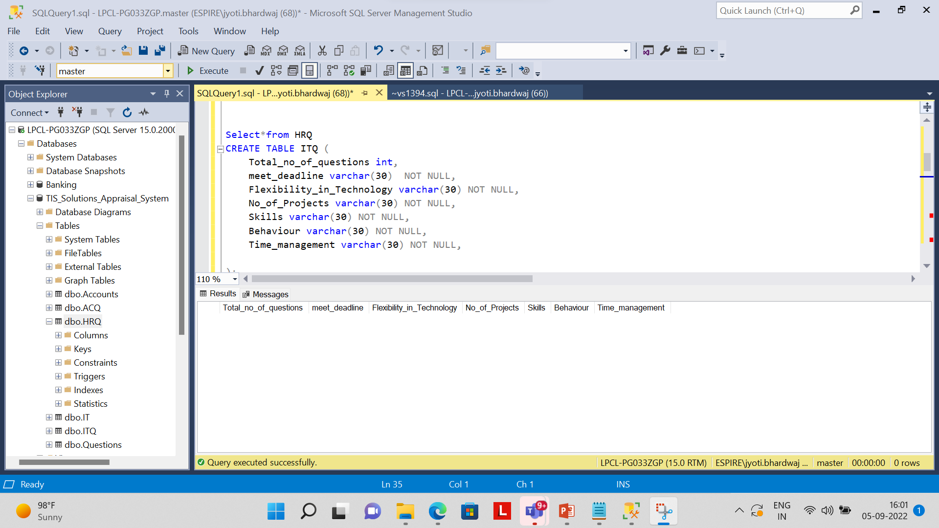
SNIPPETS FROM THE DATABASE: JYOTI BHARDWAJ

Slide 13
THANK YOU

